Slide 1
CUT C7305c
Group 20
Lakshmy Sivaraman Nair
Sai Chandu Gangaraju
PARAMITA CHAKRABORTY

Slide 2
Problem Statement
Given data contains details of various markers and financial ratios of entities
Target Variable is whether a company went bankrupt or not in the subsequent years
Build a model to ascertain the bankruptcy of a company.
A target variable value of ‘1’ is the positive class here, which means that those companies went bankrupt
F1 – score which is a harmonic mean of Precision and Recall is being used to evaluate the model

Slide 3
Data
Given details of various markers and financial ratios of entities
Run descriptive stats to understand the attributes
64 attributes (all are numeric) and 37K companies
Plot histograms of the numeric variables to understand the distributions
Most numeric attributes have a heavily skewed distribution (with positive and negative values)
Box plots to identify any outliers
There are a lot of missing values
There are some high correlations among the variables, correlation values being as close to +1 and -1
There is a class imbalance (only 5% of the data has target variable as ‘1’)

Slide 4
Data Processing
Features Removed : “ID” – Since it is discrete variable and has no use in building the model.
Imputation Used : Central Imputation ( There are NA’s in the dataset , we have used central Imputation method to impute missing Values)
Standardizing : Data is standardized using the method = c("center", "scale")
Some of the understanding steps we executed str(), head(), tail(), summary()
Following Describes how the target class is balanced.
print(prop.table(table(bankruptcy$target))) - Proportion of target variable
0 1
0.95 0.048
At 5%, this is clearly a skewed data set

Slide 5
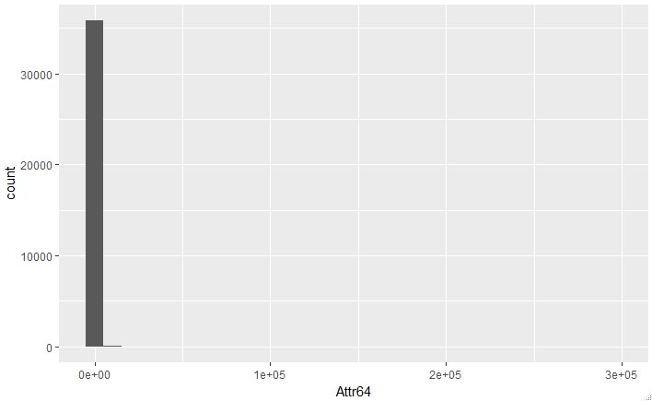
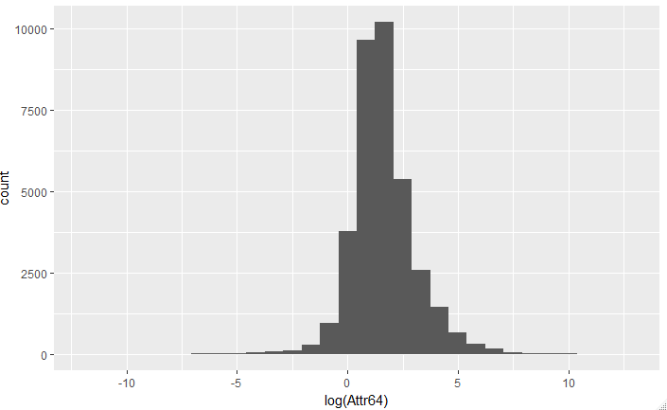
Histograms
Variables Attr5, Attr15, Attr17, Attr20, Attr30, Attr32, Attr36, Attr37, Attr40, Attr44, Attr45, Attr47, Attr50, Attr53, Attr56, Attr58, Attr59, Attr60, Attr63, Attr64 are heavily skewed
Notes:
Since it is heavily skewed, did a log transform of the attribute to understand the distribution better

Slide 6
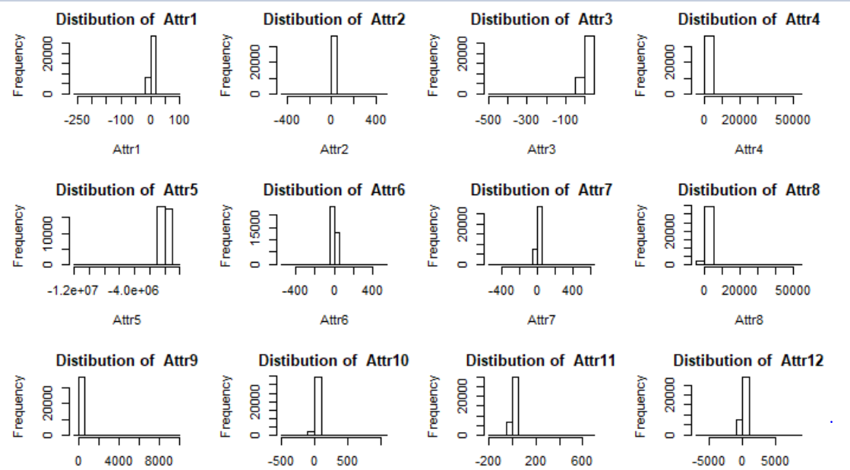
Continued…

Slide 7
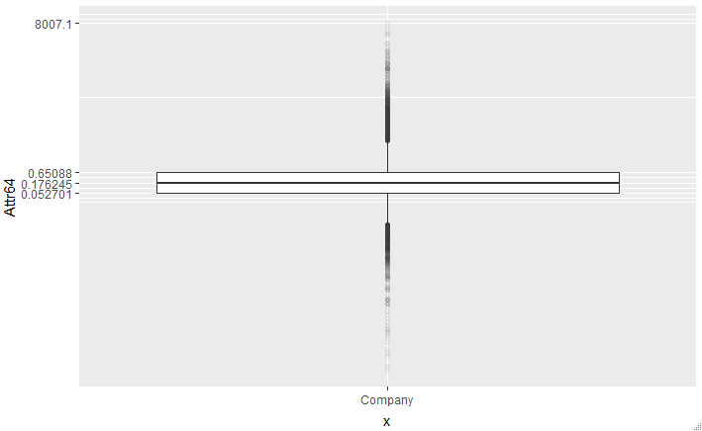
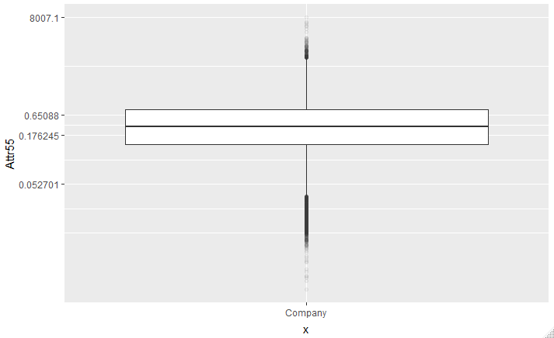
Boxplots
Attributes also seem to have a lot of outliers (Attr64 and Attr55 shown below)
Notes:
Since it is heavily skewed, we did a log transform of the attribute to understand the distribution better

Slide 8
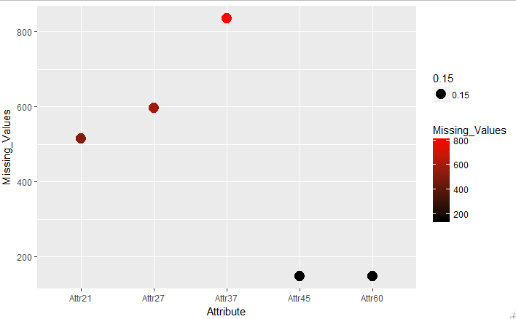
Missing Value Interpretation
For companies, that went bankrupt (target = ‘1’), below plot shows attributes with missing values >100

Slide 9
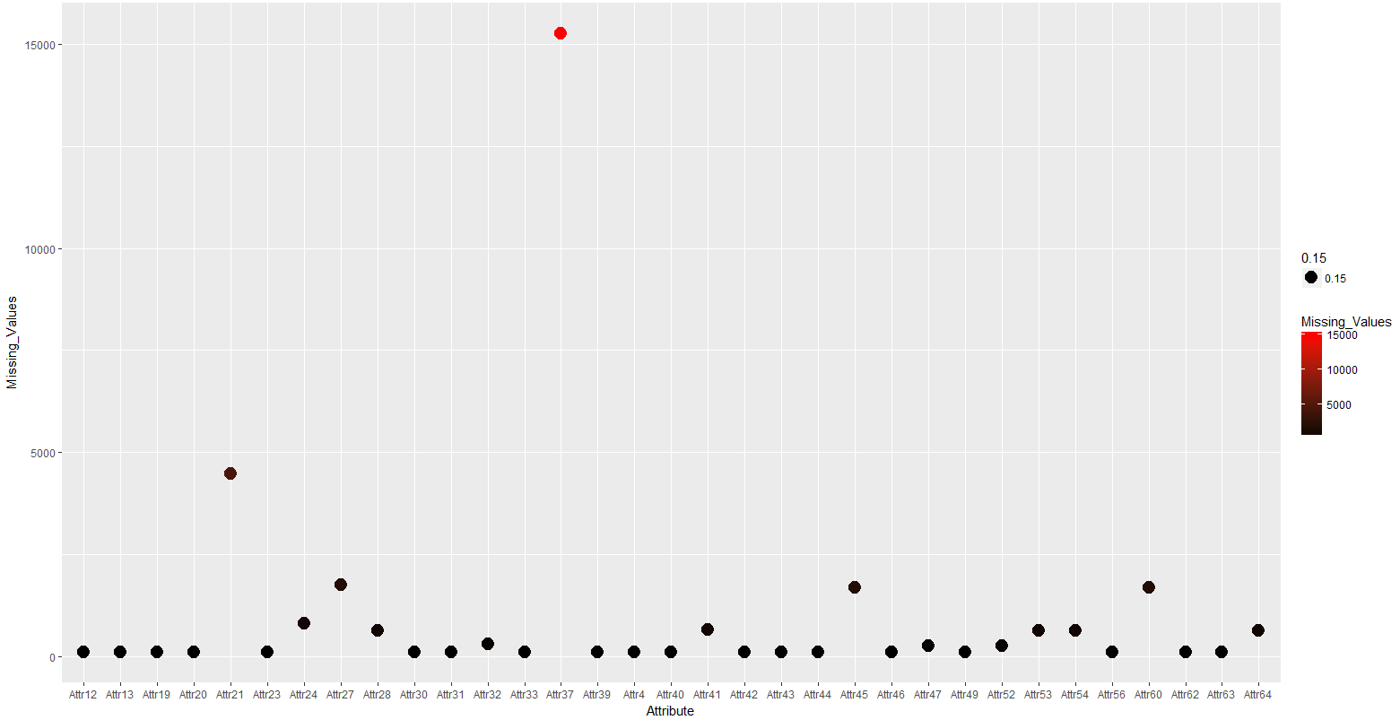
Continued… (for companies with target=0)

Slide 10
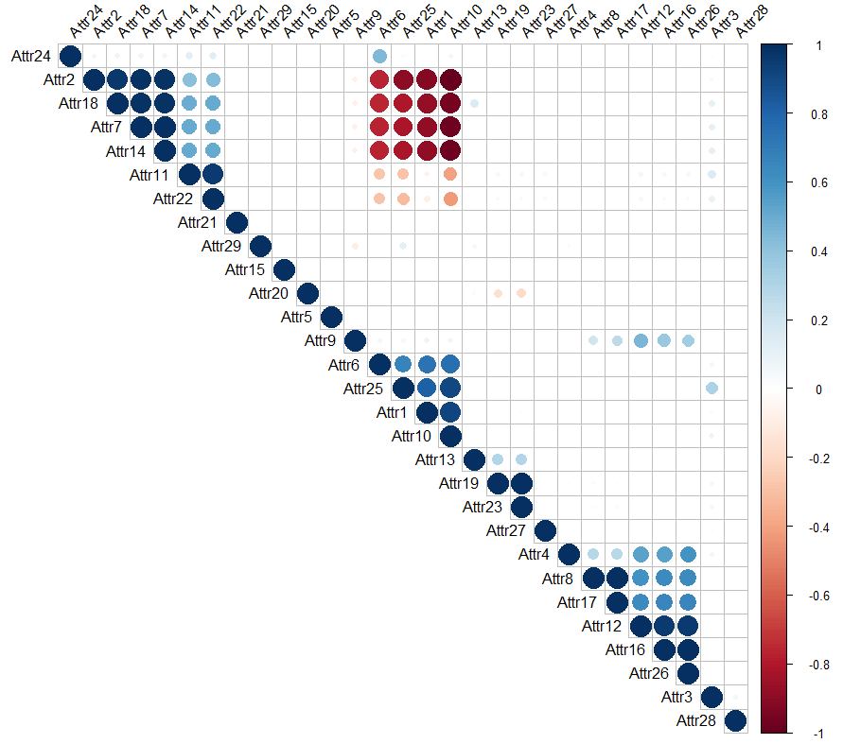
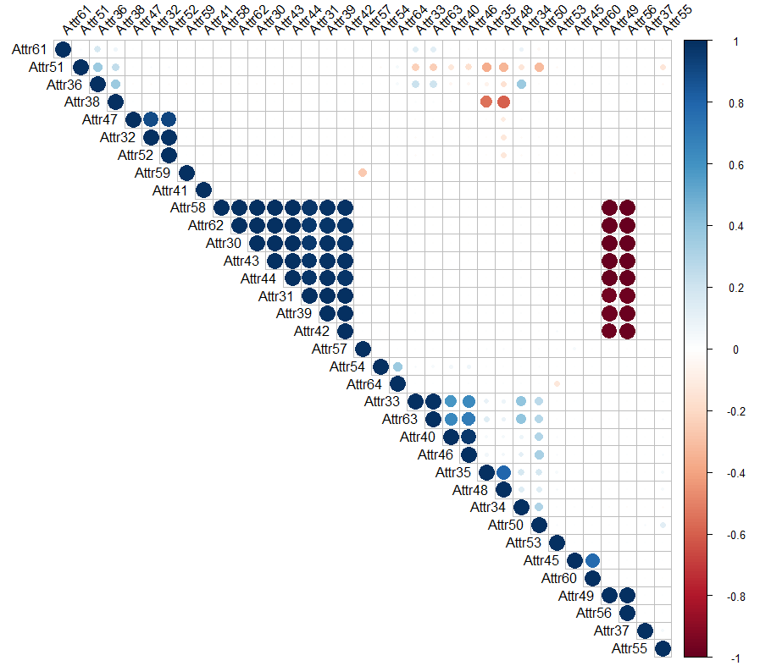
Correlations

Slide 11
Continued…
High correlation is observed among the following attributes:
#Attribute 18, 7, 14 and 2 - +1
#Attribute 10,2, 18, 7, 14, 38 - -1
#Attribute 58, 62, 30, 43, 44, 31,39, 42, 57 -- +1
#Attribute 49, 58, 62, 30, 43, 44, 31, 39, 42 -- -1
#Attribute 56, 58, 62, 30, 43, 44, 31, 39, 42 -- -1
#Attributes 19 and 23 -- 0.8
#Attributes 8 and 17 -- 0.8

Slide 12
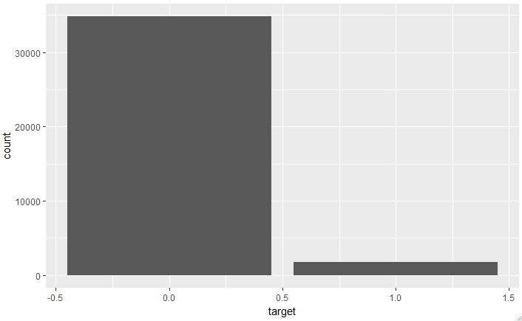
Class Imbalance
Only 5% of the data belongs to Class ‘1’

Slide 13
Model Building
Model 1 - PCA and Logistic Regression
Model 2 – Random Forest with 30 most important variables and then XGBoost
Model 3 – XGBoost with 50 most important variables

Slide 14
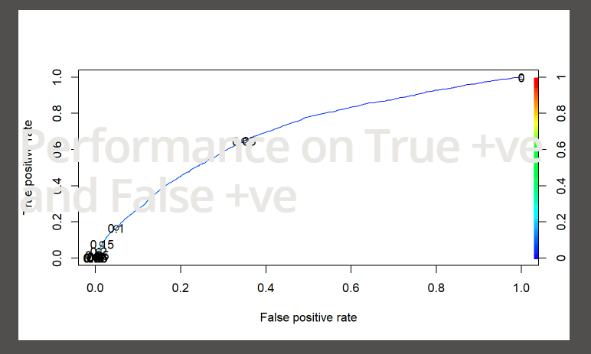
Model 1 – PCA and logistic regression
Took top 28 PCA components and build a logistic regression model
Achieved an F1 score of 20%

Slide 15
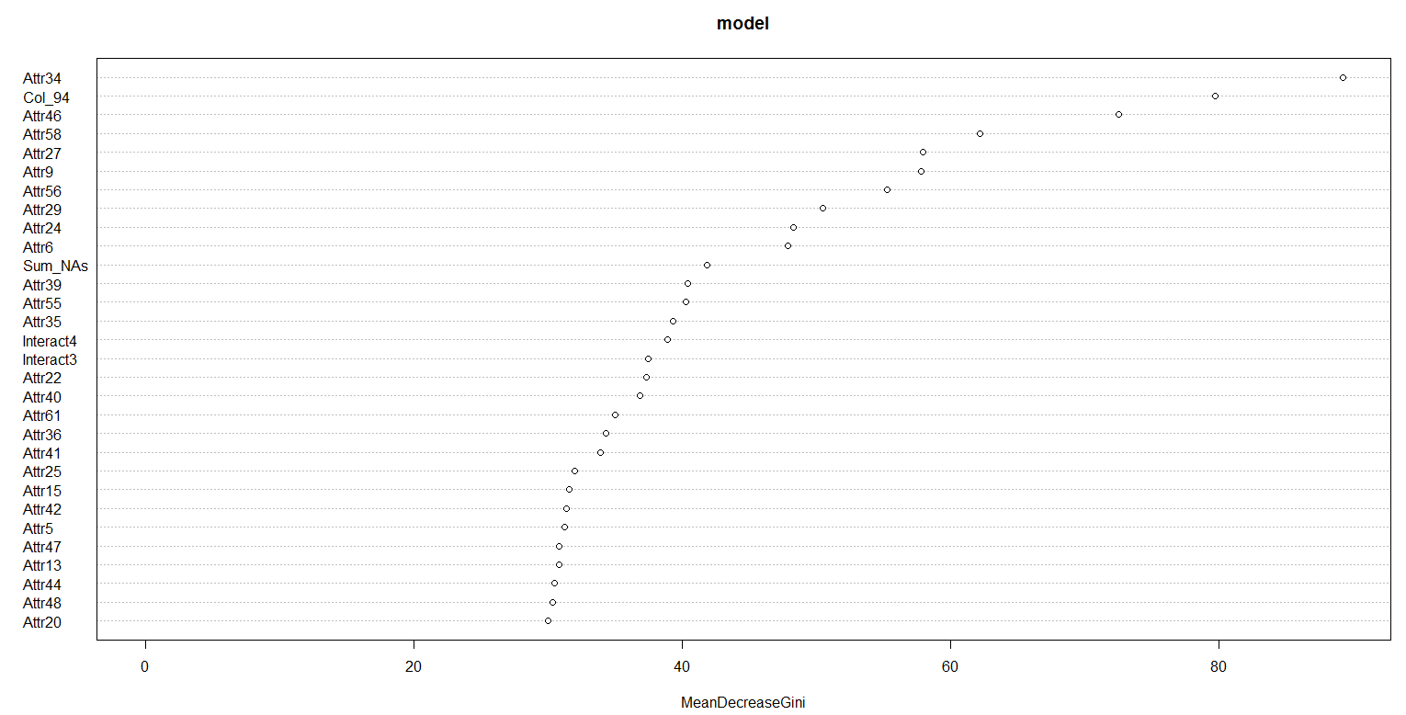
Model -2 Random Forest and XGBoost
Variable importance plot

Slide 16
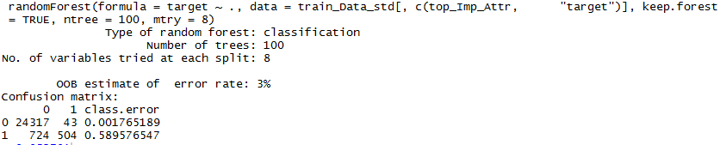
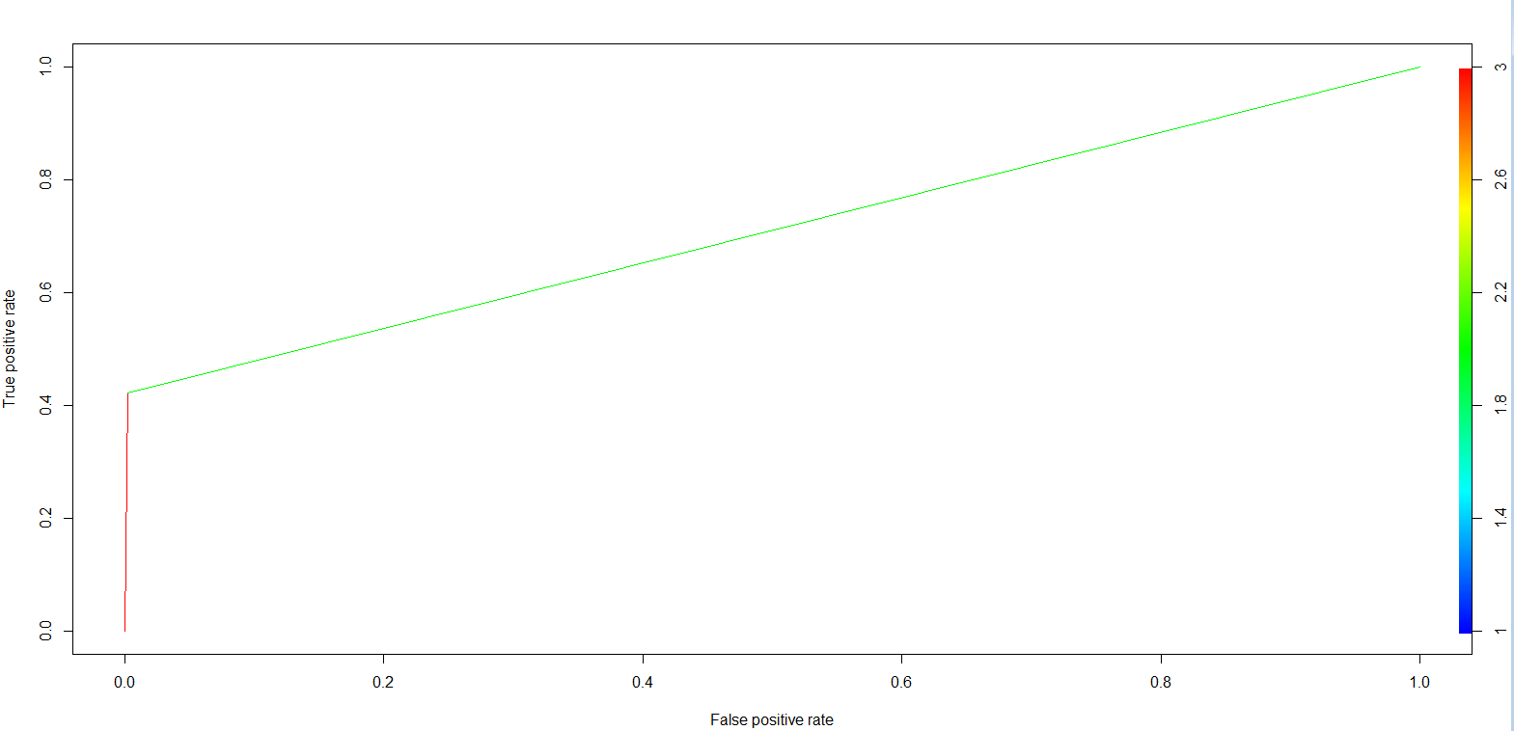
Continued…
Model output

Slide 17
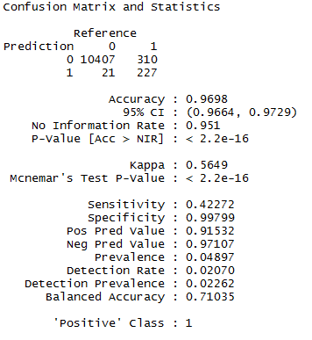
Continued…
Confusion Matrix
Achieved an F1 score of 57%

Slide 18
Feature Engineering
Added 6 new interaction terms (multiplying the highly correlated attributes)
Below are the few interaction terms used while modeling
train_data_XG$Intr1 = train_data_XG$Attr18 * train_data_XG$Attr7 * train_data_XG$Attr14
train_data_XG$Intr2 = (train_data_XG$Attr11 * train_data_XG$Attr7 * train_data_XG$Attr14 * train_data_XG$Attr18 * train_data_XG$Attr22 * train_data_XG$Attr24 * train_data_XG$Attr35)
Dropped features having more that 10% of missing values (Attr21 and Attr37)
Added dummy columns using 1-hot encoding to devise new synthetic features from missing values for each feature in the original dataset
Added a synthetic feature which captures the no. of missing values for each observation (row)
Central Imputation for the given features
https://www.ii.pwr.edu.pl/~tomczak/PDF/[MZSTJT].pdf
https://gupea.ub.gu.se/bitstream/2077/54283/1/gupea_2077_54283_1.pdf
Notes:
Reference papers:
https://www.ii.pwr.edu.pl/~tomczak/PDF/[MZSTJT].pdf
https://gupea.ub.gu.se/bitstream/2077/54283/1/gupea_2077_54283_1.pdf

Slide 19
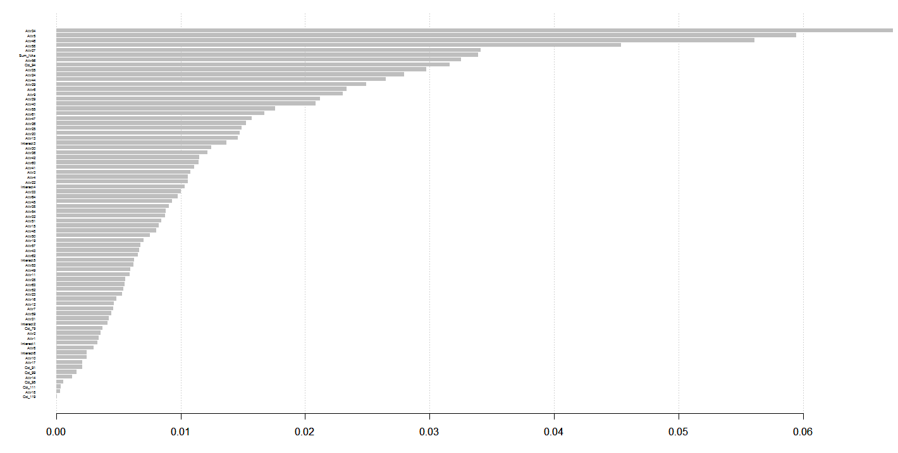
Model -3 XGBoost
Variable importance plot
Notes:
Used 4 K-fold cross validation to choose the optimum value if lambda

Slide 20
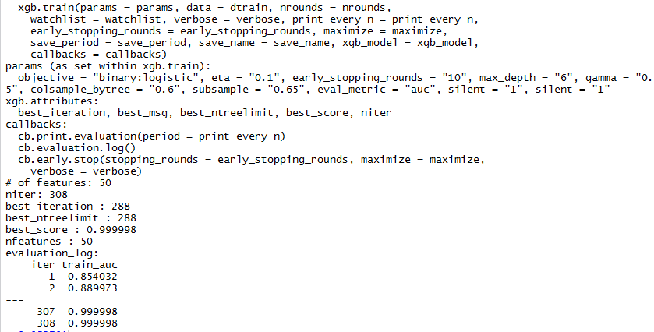
Continued…
Model output

Slide 21
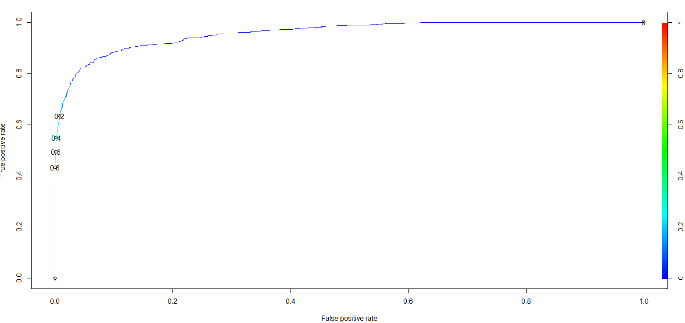
Continued…
AUC plot – 96% auc

Slide 22
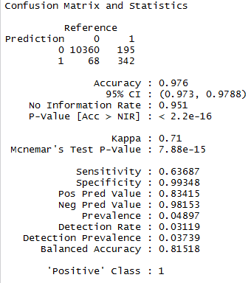
Continued…
Confusion Matrix
Achieved an F1 score of 77%

Slide 23
Thank You

